Slide 1


In the Name of God
Chapter 3: Gamification
Let’s learn new words!

Slide 2

Accumulate [v]
/əˈkjuːmjʊleɪt/
The detector is accumulating enough evidence to find the murderer.
Collect/gather

Slide 3

Alternative [Adj]
/ɒlˈtəːnətɪv/
Available as another possibility or choice
FIFA2021 could not be a cool alternative to PES2021.

Slide 4

Ambassador [N]
/amˈbasədə/
A representative/promoter of a specified activity
Who is interested in becoming Microsoft ambassador?

Slide 5
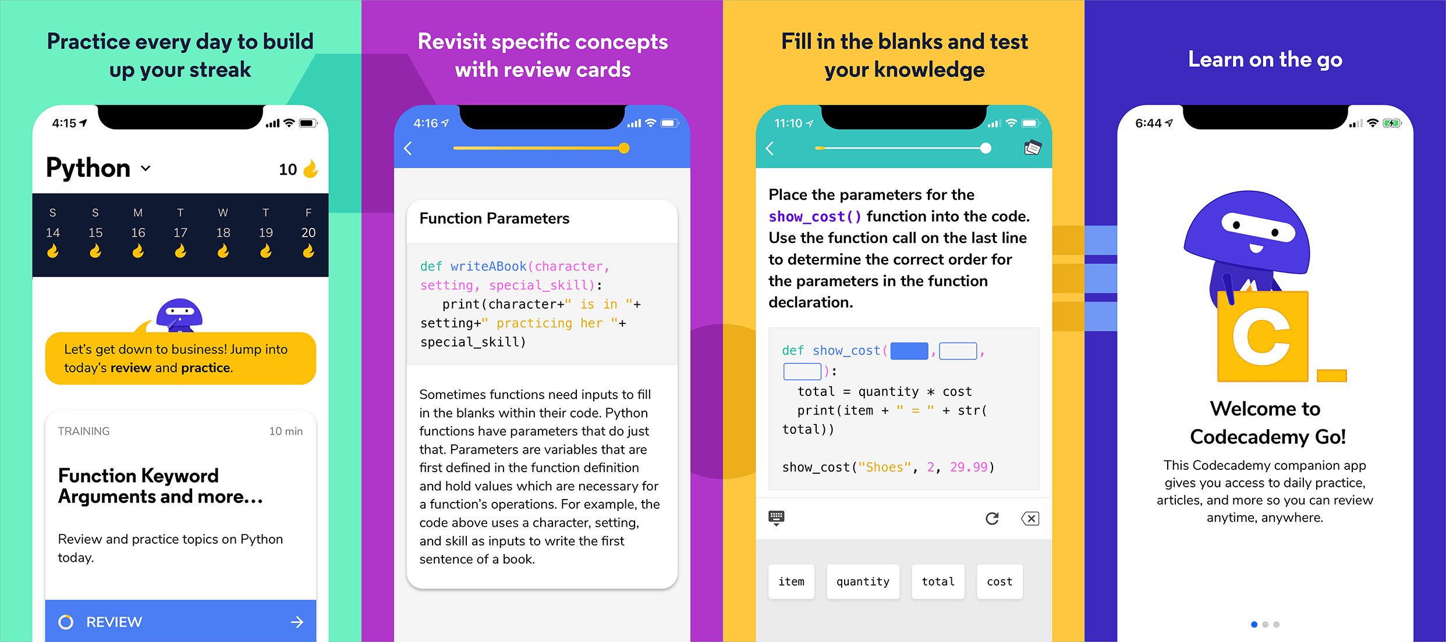
Apply [V] /əˈplʌɪ/
to use something for a practical purpose
Codecademy Go applies gamification principles to coding practice!

Slide 6

Appropriate [Adj] /əˈprəʊprɪət/
Games inducing intense violence are not appropriate for both children and adults.

Slide 7

Badge [N]
/badʒ/
In some online courses, you can earn weekly badges.

Slide 8

Console [N]
/ˈkɒnsəʊl/
A small electronic device for playing computerized video games.

Slide 9
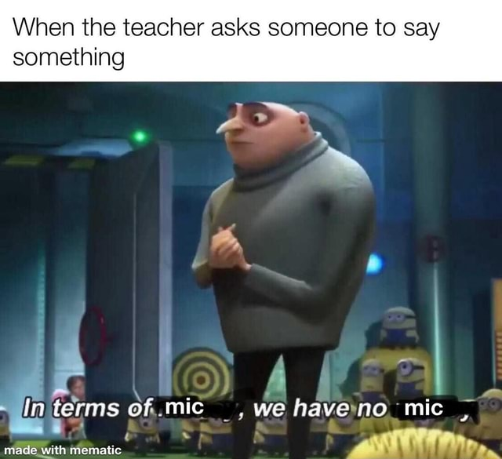
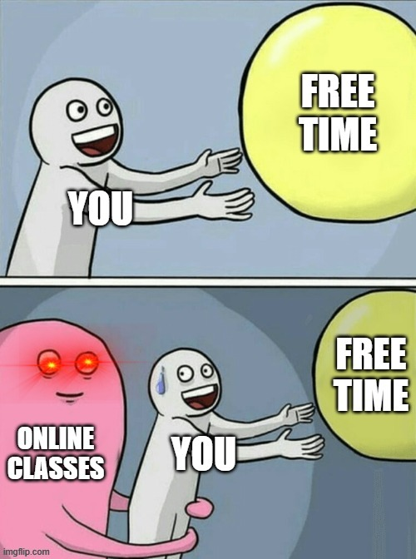
Dimension [N] /dɪˈmɛnʃ(ə)n/
An aspect or feature
Which dimensions of online classes do you like more?

Slide 10

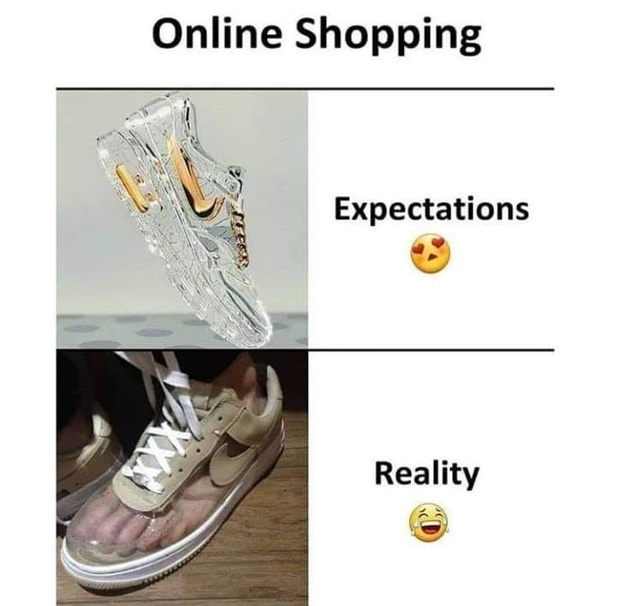
Emerging [Adj] /ɪˈməːdʒɪŋ/
Just beginning to exist
During pandemic, online purchase has turned into an emerging trend for some families.

Slide 11

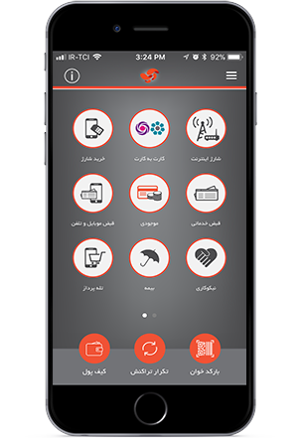
Facilitate [V] /fəˈsɪlɪteɪt/
Make (an action or process) easier.
Some apps facilitate the process of online payment and online transaction.

Slide 12

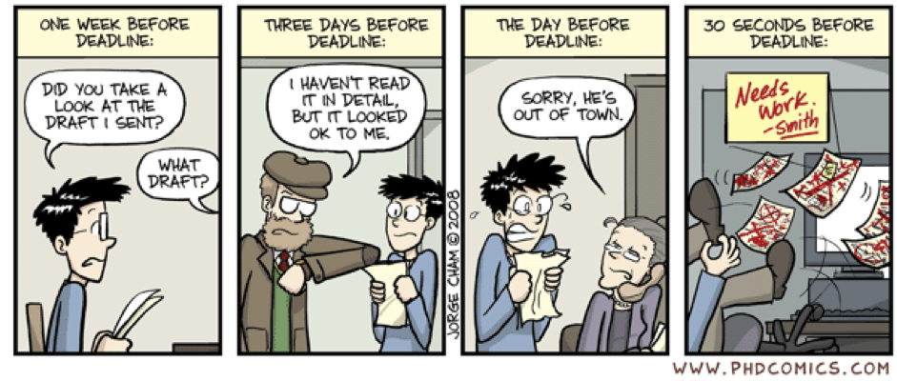
Feedback [N]
/ˈfiːdbak/
Statements about something, such as a new product, that can tell you if it is successful:
Yesterday, I received the reviewers’ feedback on my manuscript.

Slide 13
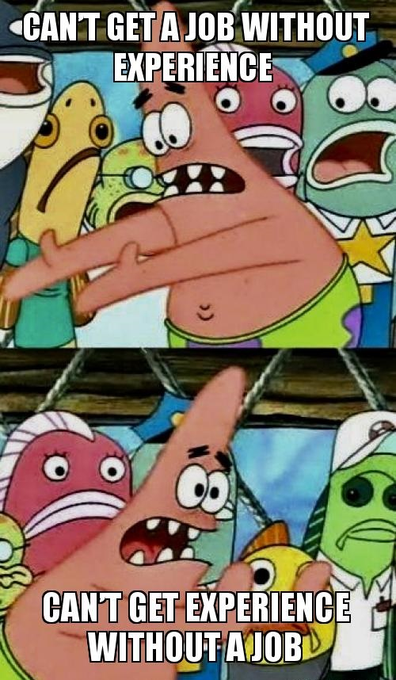

Gain [V] /ɡeɪn/
Get, obtain
After you've gained some experience, you can get a job.

Slide 14

Loyalty [N] /ˈlɔɪəlti/
A strong feeling of support
His loyalty was never in question!
Motivate [V] /ˈməʊtɪveɪt/
Provide (someone) with a reason for doing something
He is motivated by a desire to help people.

Slide 15
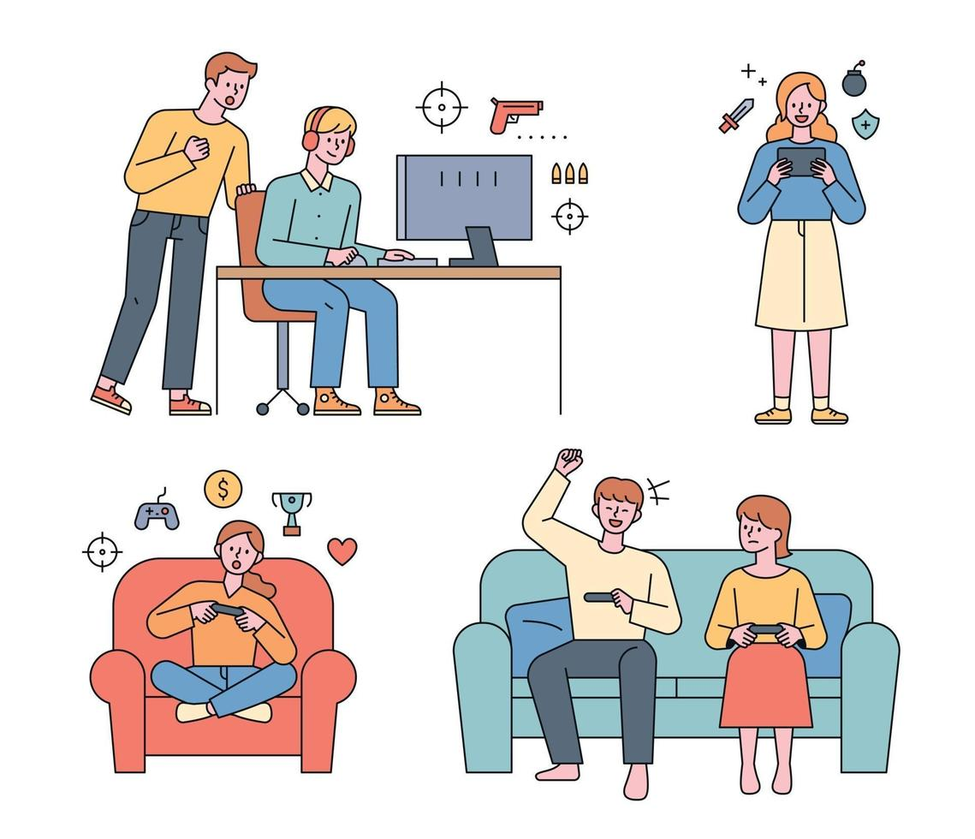
Outplay [V]
/aʊtˈpleɪ/
Play better than
Which team is going to outplay?

Slide 16

Profession [N]
/prəˈfɛʃ(ə)n/
any type of work that needs special training or a particular skill
Entrepreneurs leave their 9-to-5 professions to establish their own start-up companies.

Slide 17

Profitable [Adj]
/ˈprɒfɪtəb(ə)l/
Beneficial, useful

Slide 18
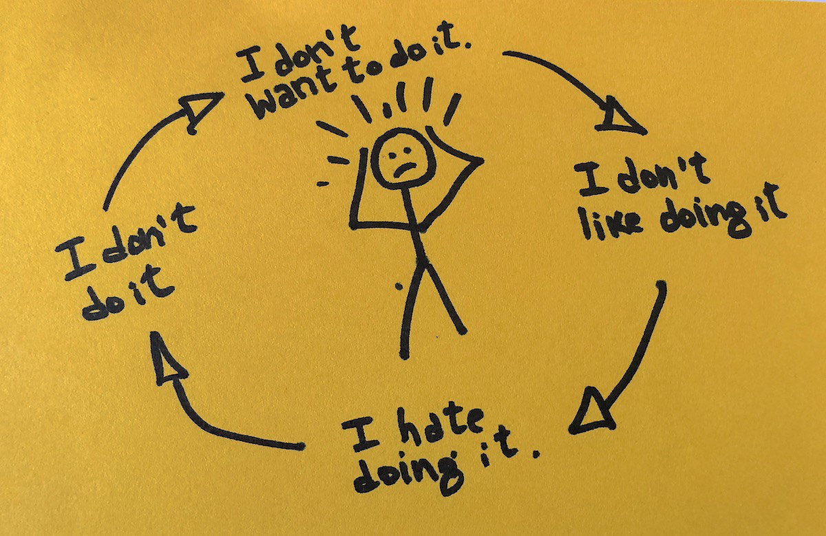
Stem [v]
/stɛm/
Originate in or be caused by
Our problems stem from procrastination.

Slide 19


